Slide 1
Glassdoor Test Answers
Abhishek Pravin, Mane
San Francisco State University

Slide 2
Q1 - Google BigQuery
select h.State_Name, DATE_TRUNC(h.StartDate, MONTH) as Month ,sum(h.Total_Contract_Value) as Total_Contract_Value from (
select g.*,f.City_Name, f.State_ID, f.State_Name from
gdoor.gdoor_slot_performance as g inner join gdoor.gdoor_location as f on g.City_ID = f.City_ID)
as h group by h.State_Name, Month order by h.State_Name, Month;
Q2
select * from (
select Employer_ID, ROW_NUMBER() over (
partition by Employer_ID
order by Employer_ID, StartDate
) AS ROW_NUMBER, Job_Slots, Click_Market_Value from gdoor.gdoor_slot_performance
) where ROW_NUMBER = 2;

Slide 3
Q3 –Metric Design
Renewal_Flag - True/false metric indicating whether the contract was renewed at the end of the contract: 1 = renewed, 0 = not renewed
Graphs on next pages made in Tableau and other analysis in Weka –
Renewal_Flag over time Quarter
Job_Slots over time Quarter
Stacked Bars graph for click_market_value
Box Plot of Total_Contract_Value
Correlation matrix

Slide 4
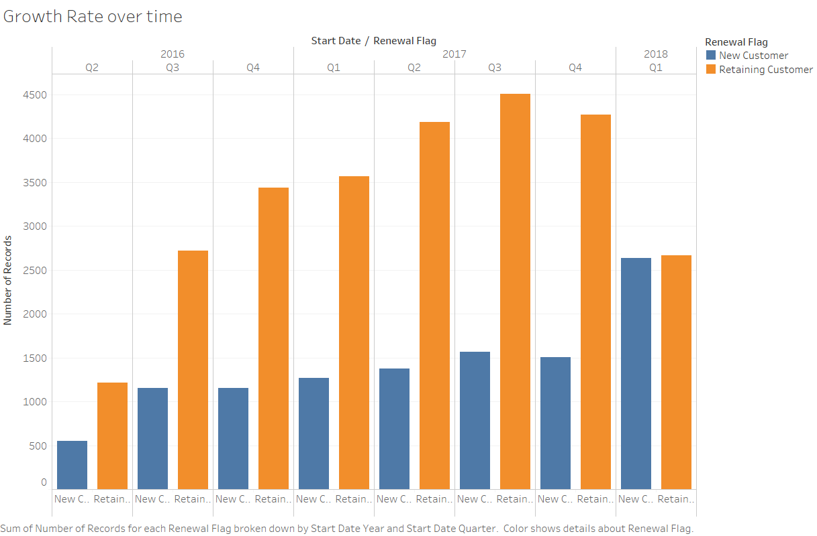
A good metric would be analysis of number of job_slots renewed over time and new customers obtained / growth rate.
- New customers should be equal or more than last quarter.
Customers retained should be equal to new customer from last quarter + older retained customer.
Taking into consideration job hiring process takes 1-2 months or more.

Slide 5
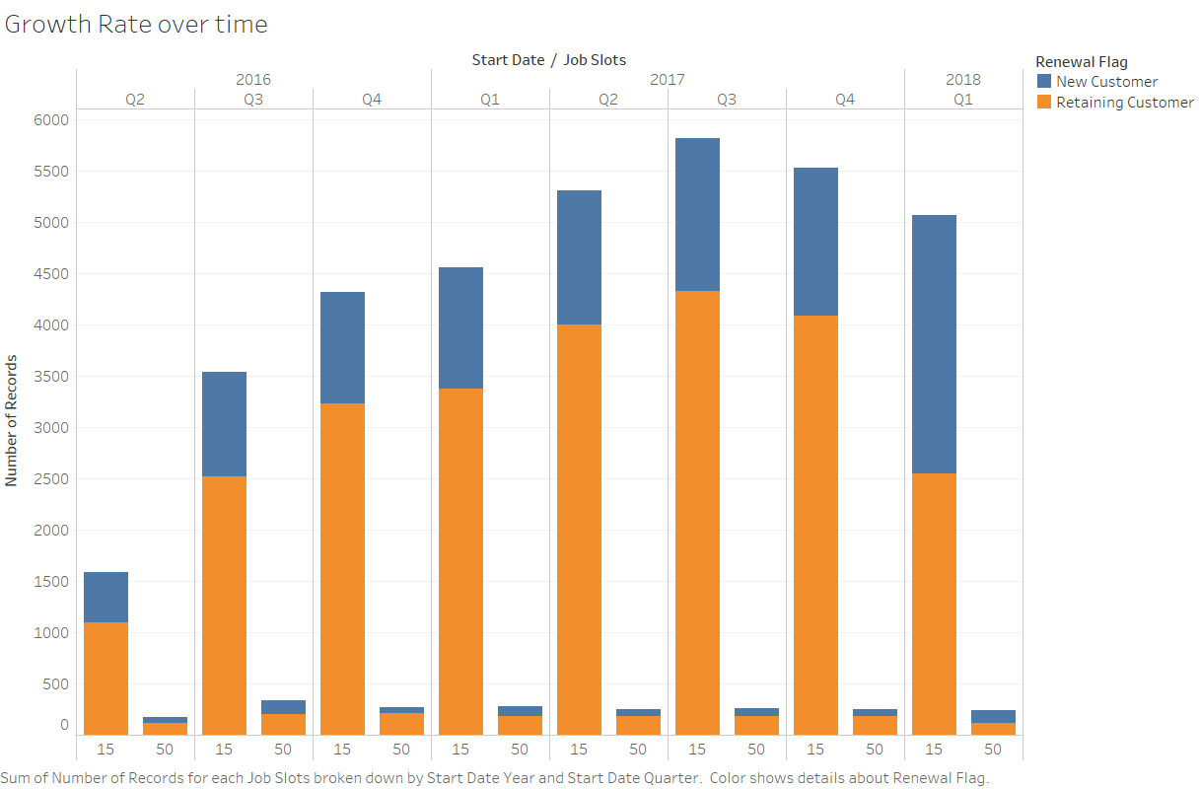
Performance using Job_Slots metrics quarterly

Slide 6
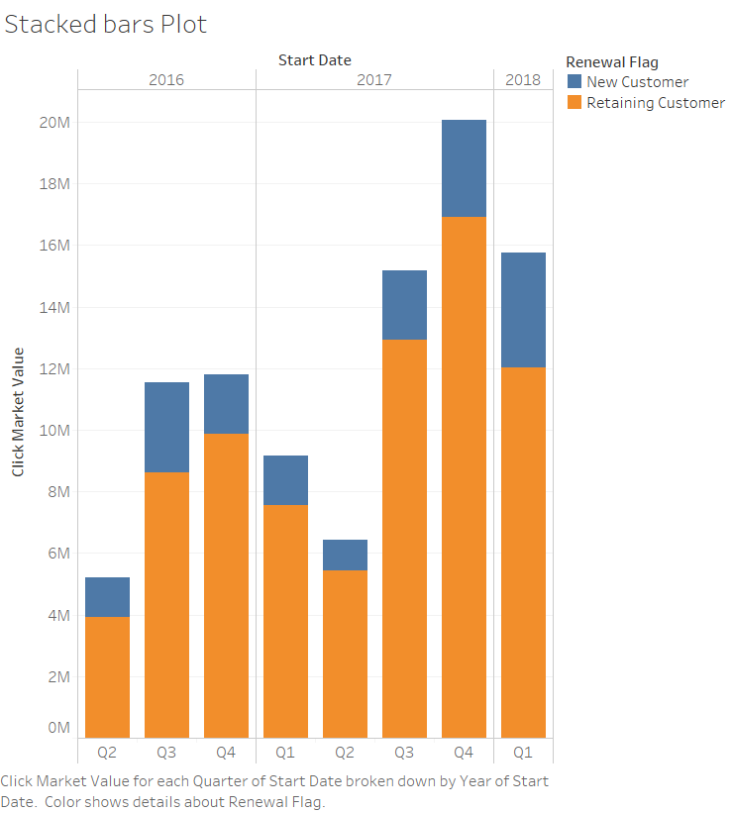
Performance using Click_Market_Value quarterly

Slide 7
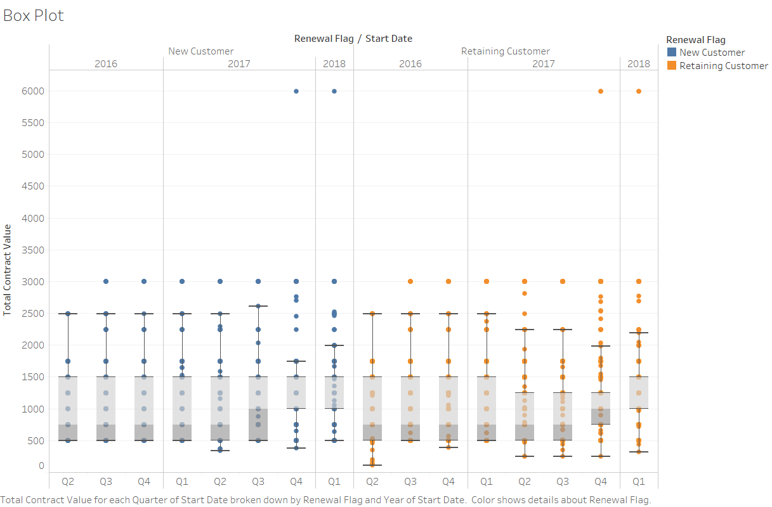
Performance using Total_Contract_Value quarterly

Slide 8
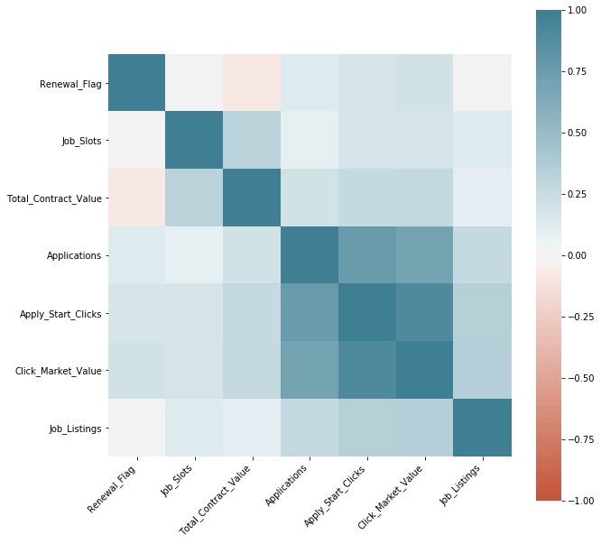
Correlation Matrix
From the matrix we can make following inferences:
Increase in the price of total_contract_value may lead to a decrease in renewal of customer.
The more the number of successful applications or apply_start_clicks is directly proportional to the market value they bring.

Slide 9
Q4 Retention Analysis
I tried ‘Information gain attribute evaluator’ and ‘classifier subset evaluator’ to evaluate the information gain from each attribute. This was also backed by a decision tree J48 algorithm which chose click_market_value as the root node.
Other features that make a significant contribution are Apply_Start_Clicks, Total_Contract_Value, StartMonth, EndMonth, Applications.
Also tried PCA (Principal component Analysis) but wasn’t good enough.

Slide 10
Q4 Retention Analysis (Information Gain Attribute Evaluator)
Attributes | Feature Importance
Click_Market_Value | 0.065256
Apply_Start_Clicks | 0.032553
StartMonth | 0.032544
EndMonth | 0.028648
Applications | 0.016128
Total_Contract_Value | 0.011309
Job_Listings | 0.001835
Job_Slots | 0.000216
State_Name | 0.000105
Click_Market_Value is the highest contributer to predict customer retention.
A major focus of our resources should be increasing number of apply_start_clicks as the click_market_value is directly proportional to it as seen in the correlation matrix.

Slide 11
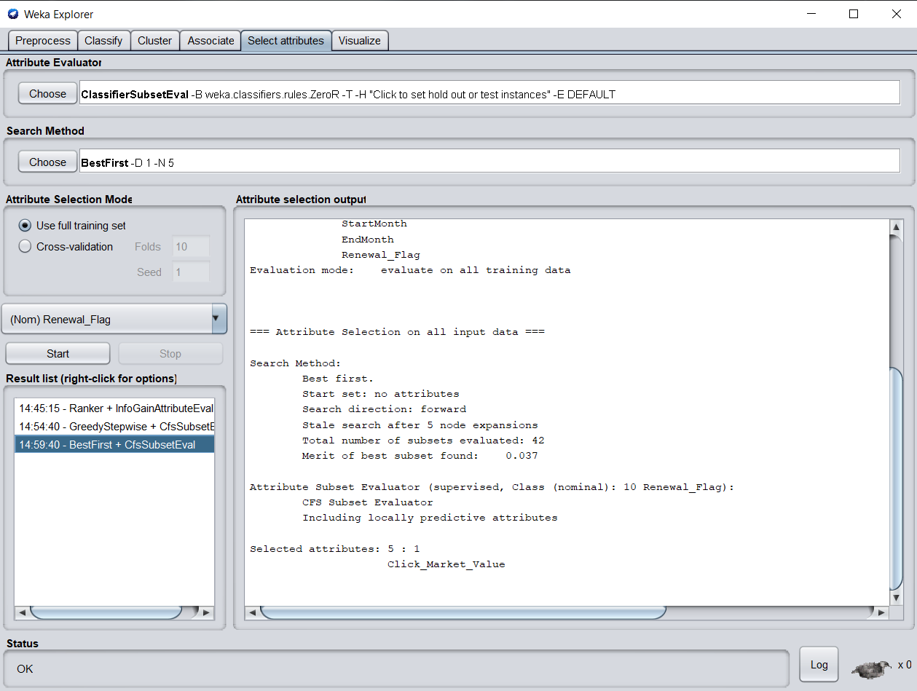
Q4 Retention Analysis (Classifier Subset Evaluator)
We also confirm click_market_value has highest value using another algorithm called classifierSubsetEvaluator as indicated in the screenshot.
Next is screenshot of Tree obtained from training on decision tree algorithm which also shows the same.

Slide 12
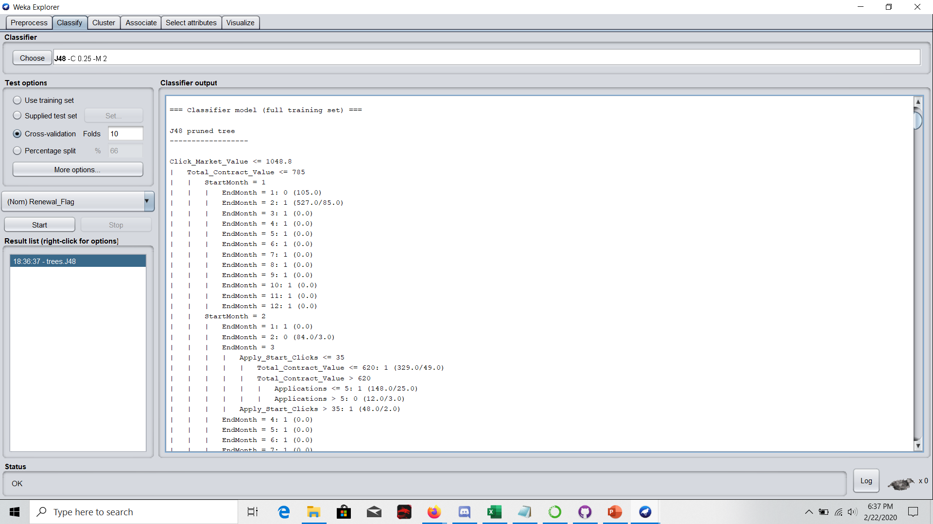

Slide 13
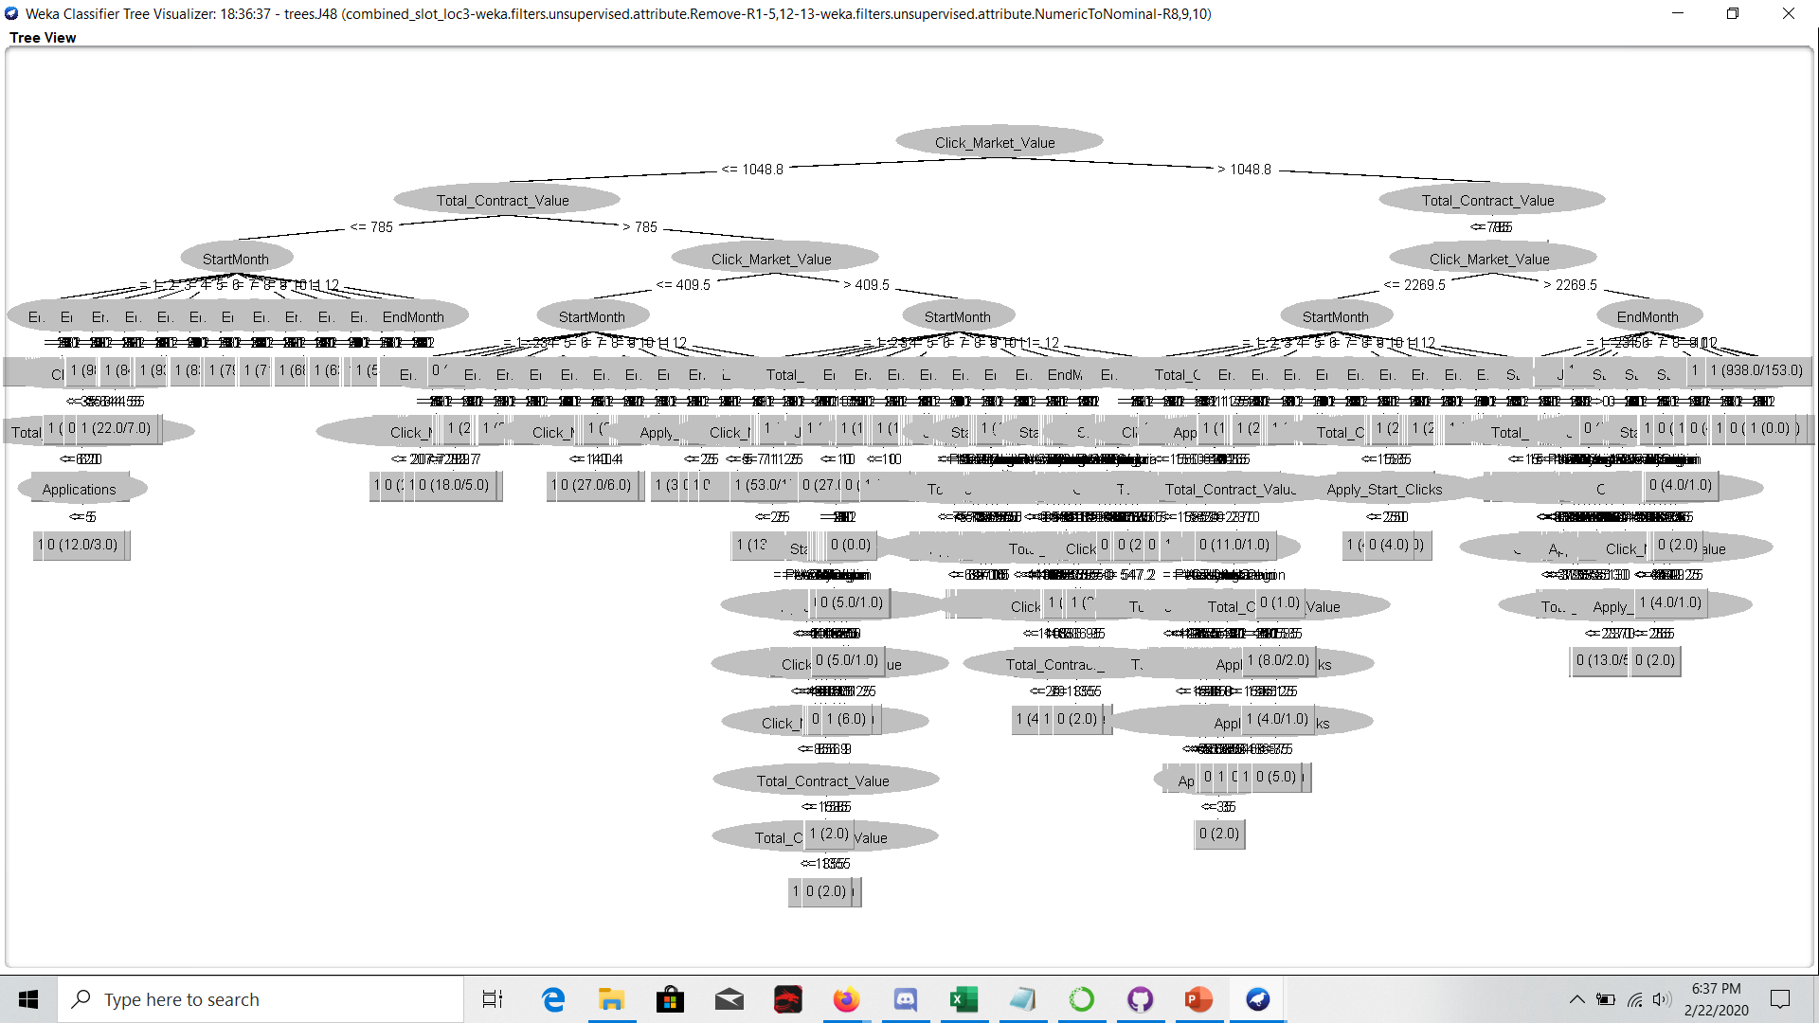

Slide 14
Q5 Retention Analysis (Performance of model)
Algorithm | Precision for Class 0 | Precision for Class 1 | Recall for Class 0 | Recall for Class 1
J48 Decision Tree | 0.836 | 0.814 | 0.479 | 0.96
ANN Multilayer Perceptron | 0.8 | 0.818 | 0.5 | 0.948
K-Nearest Neighbours | 0.721 | 0.816 | 0.511 | 0.917
Random Forest | 0.733 | 0.816 | 0.508 | 0.922
From above we can see that J48 Decision Tree and ANN are the top 2 players.
Next 2 slides show training results for J48 Decision Tree and Artificial Neural Network (Multilayer Perceptron) algorithms.

Slide 15
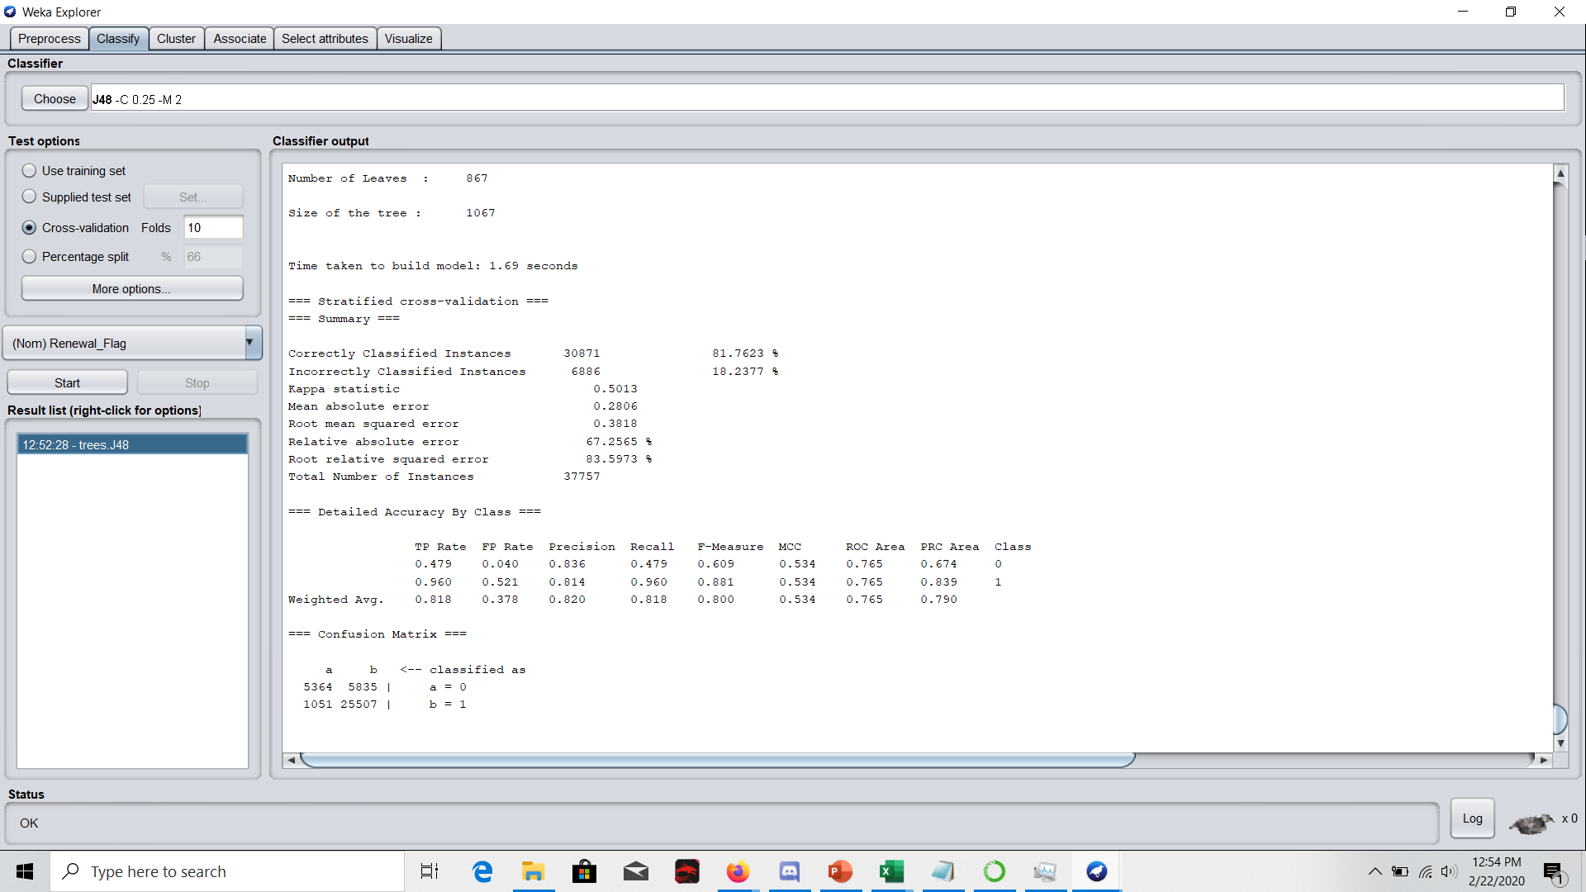
J48 Decision Tree - Weka

Slide 16
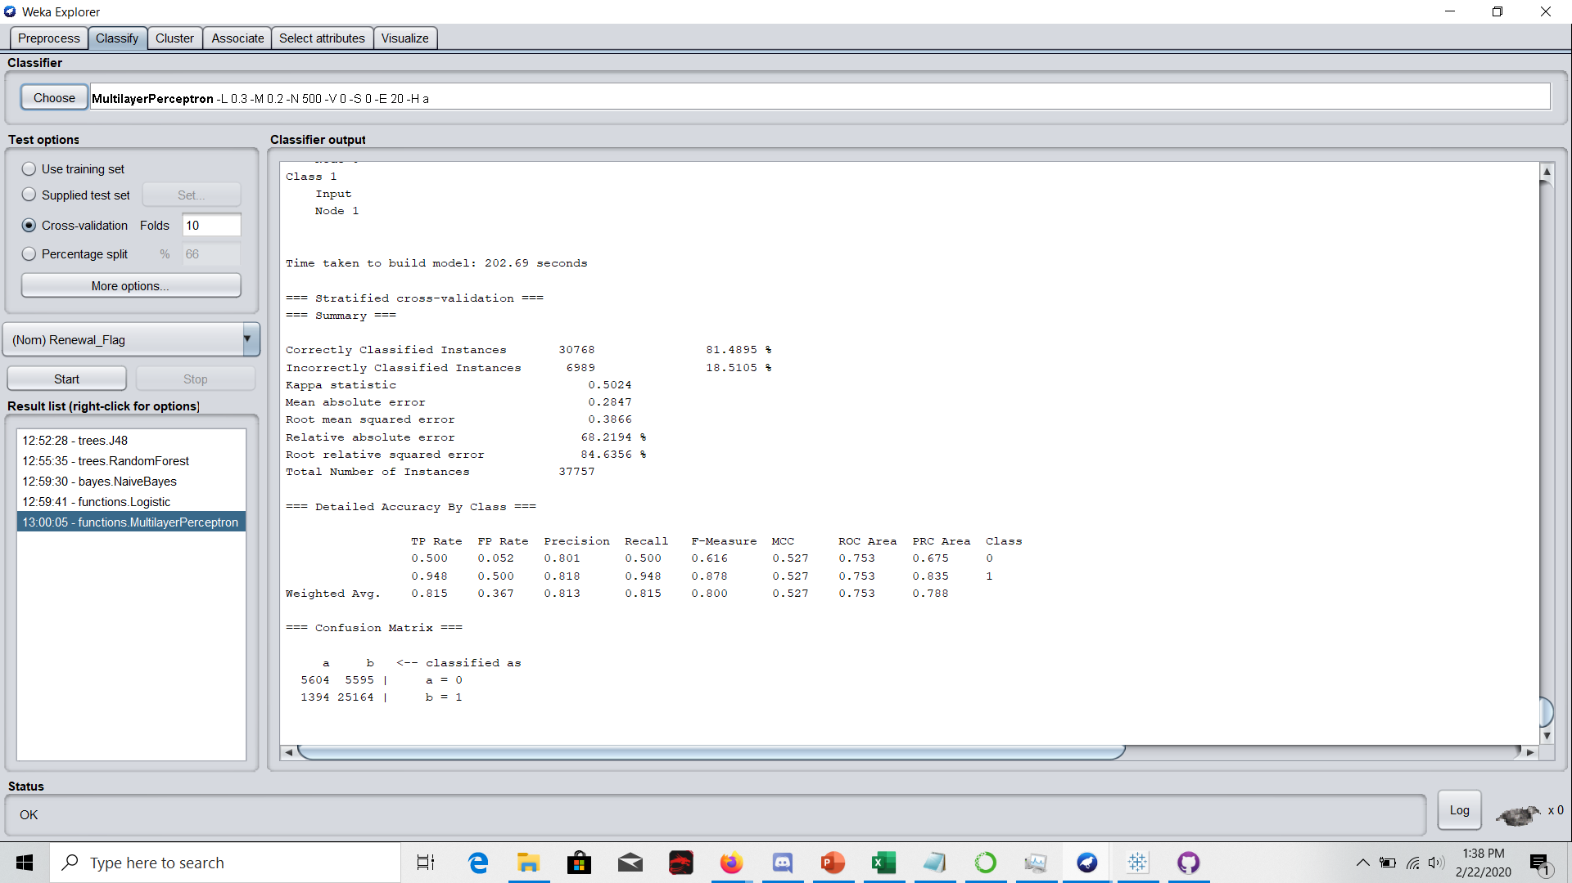
Artificial Neural Network (Multilayer Perceptron) - Weka

Slide 17
Q6 Retention Analysis (Recommendation)
We can observe the Statewise growth-rate and make recommendation of appropriate job_slot package to that particular state. Thus we can have different job_slot packages for different states.
To make regional job_slot size recommendation according to state. This can be done by analyzing the correlation between job_slot and number of application.
Based on the analysis I did, I felt there should be more Job slot variations (right now there are only 2 – 15 and 50).
Understanding the click_market_value - how it was obtained - might also help understand how to make better analysis.

Slide 18
Thank You

